Slide 1

POWER, architecture, OSes, assembly, and ABIs
Data, AI, and Automation

Slide 2
Brief history of POWER architecture
Agenda
1. Architecture details
ISA
Registers
Addressing capabilities
Typical instructions
Running modes
Implementations
Simultaneous Multi-Threading
3. OSes
Hypervisor and virtualization
AIX
LE Linux
BE Linux (phased out)
Address space
2. Assembly programming
Calculation example
Branch example
Calling example
Return example
4. ABIs: Application Binary Interface
Register conventions
Stack frame
Argument passing

Slide 3
POWER
ISA: Instruction Set Architecture
Brief history
70s: Watson research project 801 and legendary IBM Fellow John Cocke
80s and 90s: Debate on RISC vs. CISC
RS6000 system
PowerPC (IBM, Toshiba, and Apple)
64bit ISA extension
PowerAS
OpenPower
Most current implementation: POWER10
A specification for both hardware implementation and software construction primitives
Three ISA books:
User level ISA
integer/fixed-point
floating point
vector
VMX
VSX
branch
Virtual environment ISA
Operating environment ISA
ISA examples:
64bit integer divide
divd RT, RA, RB
integer rotate instruction
rlwinm RA, RS, sh, mb, me
instructions for lock construction
lwarx RT, RA, RB, EH
stwcx. RT, RA, RB
datum atomicity (word/byte tearing)
java arrayCopy

Slide 4
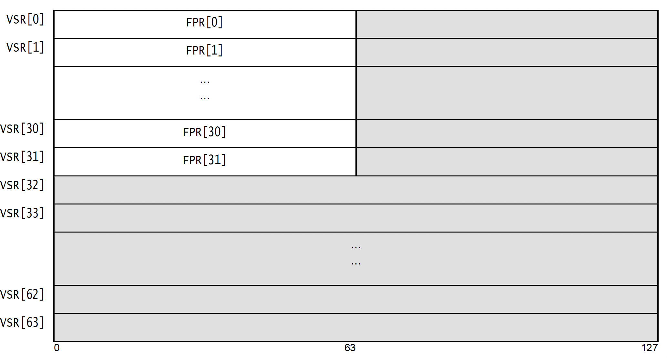
Architecture Details
Addressing capabilities
Registers
GPRs: General Purpose Registers – 32 (special meaning of r0 in some cases)
FPRs: Floating Point Registers – 32
VR (for VMX): Vector Registers – 32
VSR (for VSX): Vector Scalar Registers – 64
CR: Condition Registers – 8
SPR: Special Purpose Registers – LR and CTR
Control and Status Registers: XER, VRSAVE, FPSCR, VSCR (one each)
Only load/store instructions deal with memory. Other instructions only use register operands or produce results in register. This is a characteristic of RISC architecture, whereas CISC architecture can have memory operands in their arithmetic instructions for example.
How memory addresses are designated in instructions is the addressing capabilities we are going to talk about.
Essentially, POWER architecture supports two addressing formats:
Immediate form: R + 16-bit I-value
Indexed form: R1 + R2

Slide 5
Architecture Details
Running modes
Typical instructions
Fixed Point Instructions: load, store, arithmetic, logical, compare, and branch (including call/return)
Floating Point Instructions: load, store, arithmetic, compare, FMA, and conversion
VMX instructions: load, store, arithmetic, logical, compare, pack/unpack, permute, and crypto
VSX instructions: load, store, arithmetic, double vector, 64b integer vector, permute
CR logical instructions
This is a very complicated topic, covering a wide range of contents. We only focused on what are relevant/important to user-level. We are not going to touch things like: Real-Mode addressing, Virtual Real-Mode addressing, Hashed Page-Table, Radix Page-Table, Effective Segment, or Virtual Segment etc.
32bit vs. 64bit modes:
Not safe to run 64bit instructions in general in 32bit mode;
BE vs. LE modes:
Big-Endian mode
Little-Endian mode

Slide 6
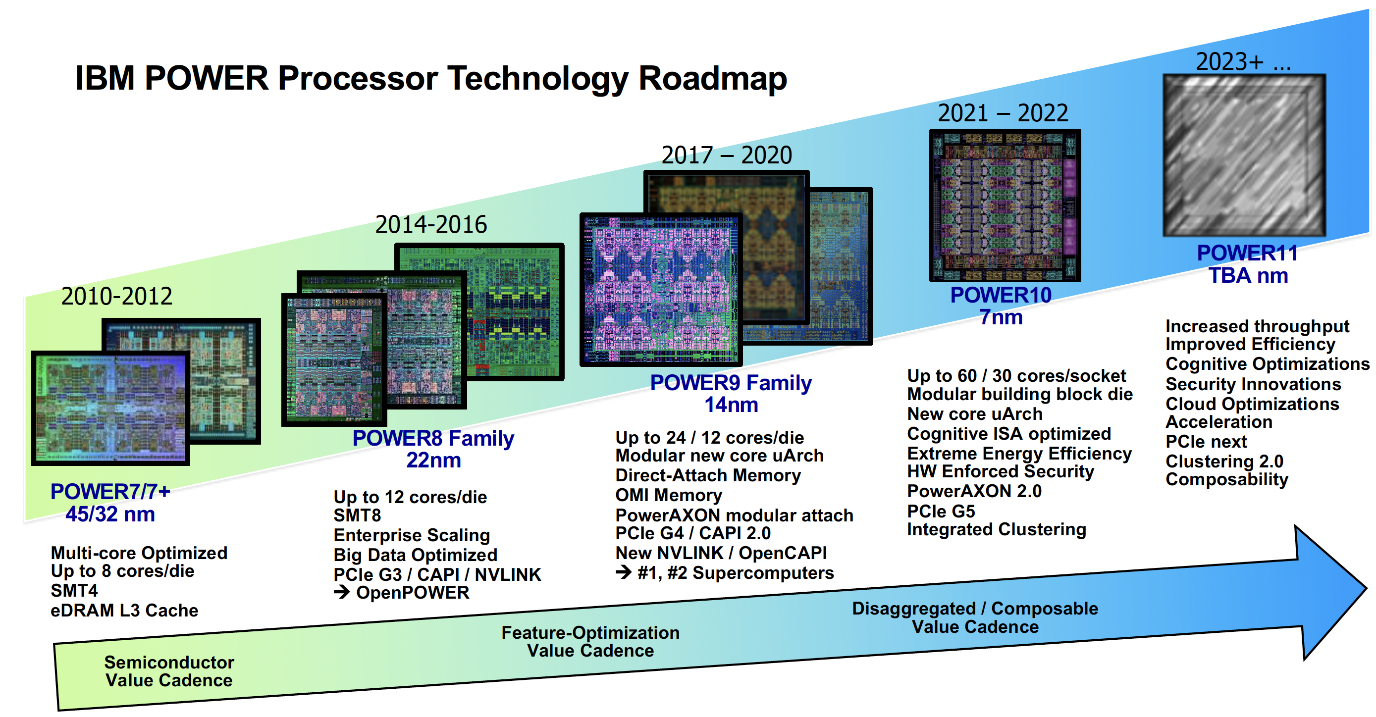
Architecture Details
SMT
Simultaneous Multi-Threading
Implementations
POWER (RIOS1)
FreeScale PPC
IBM/Toshiba/Apple PPC
PPC604 (32bit only)
POWER2 (32bit only)
POWER3 and POWER4
POWER5 (SMT2)
POWER6 (5GHz, SMT2)
POWER7 (SMT4)
POWER8 (SMT8)
POWER9 and POWER10 (SMT4)
Intel equivalent: hyper-threading
SMT is used more widely, including academia, literature, and industry
It is a middle-ground before going to multiple-core processors in terms of total performance on a transistor budget
Imagine: single-lane highway vs. multiple-lane thoroughfare
Most core resources are re-used, but registers have to be duplicated
From software perspective, it is just the same as multiple processors

Slide 7
Assembly Programming
Branch examples
Arithmetic examples
X = Y+Z; (all are int)
lwz r3, 128(r1)
lwz r4, 132(r1)
add r5, r3, r4
stw r5, 136(r1)
X = Y << 3
lwz r3, 128(r1)
rlwinm r4, r3, 3, 0, 28
stw r4, 136(r1)
if (x > y)
lwz r3, 136(r1)
lwz r4, 128(r1)
cmp cr0, 0, r3, r4
ble cr0, jump_label
(or simply: ble jump_label)
if (x>y || z==640001)
lwz r3, 136(r1)
lwz r4, 128(r1)
cmp cr0, 0, r3, r4
bgt cr0, fall_through_label
lwz r3, 132(r1)
lis r4, 10
addi r4, r4, 0xC401
cmp cr0, 0, r3, r4
bne cr0, jump_label
fall_through_label:
…..
if (x>y && z==64)
lwz r3, 136(r1)
lwz r4, 128(r1)
cmp cr0, 0, r3, r4
ble cr0, jump_label
lwz r3, 132(r1)
cmpi cr0, 0, r3, 64
bne cr0, jump_label
fall_through_label:
…..

Slide 8
Assembly Programming
Call return examples
Function call examples
function-call within the shared library
bl my_function
function-call outside the shared library
bl glink/plt_my_function
ld r2, 32 or 24(r1)
Return from within the shared library
ld r0, 16(r1)
mtlr r0
blr
Return from outside the shared library
The same as above

Slide 9
Operating Systems
Bare-metal machine (for OpenPOWER)
Used for:
Early hardware bring-up
LE Linux for OpenPOWER
Virtualization through PowerKVM
Hypervisor:
Virtual Machine manager
it manages all the virtual machines (i.e. OS instances) running on the same physical machine.
PowerVM (aka. pHYP)
LPAR (Logical Partition)
Dedicated LPAR
SP-LPAR
Handling or transferring interrupts
Support/virtualize shared facilities
disks
network-card
Reliability
LPM (Logical Partition Migration)

Slide 10




AIX
Traditional Unix Server OS
Very robust (years without reboot)
Cannot run on bare-metal
Big-Endian only
Hashed page-table only
Effective and virtual segments
BE Linux (phased out)
Almost same as AIX
No concept of segment though
LE Linux
New ABI (addressing performance concerns)
tailored for OpenPOWER customers
Can run on both bare-metal and PowerVM
Of course, Little-Endian only
Can use either Radix or Hashed page-table
No concept of segment (underlying)
Address space
AIX: 60bit worth of address space
Linux: 48bit or 52bit worth of address space

Slide 11
ABIs: Application Binary Interface
What is it?
a specification for rules for software interaction:
global data access
subroutine linkage
register conventions
argument passing
return value
stack layout
exception handling
debugging info
object files
shared library
program loading
Limited to talk about 64bits
AIX and BE Linux
LE Linux

Slide 12
Register Conventions
General Purpose Registers:
r0: scratch/volatile
r1: stack pointer
r2: TOC base register
r3-r10: argument & return value
r11: scratch & environment pointer
r12: scratch
r13: reserved
r14-r31: preserved
Condition Registers:
cr0-cr1: scratch
cr2-cr4: preserved
cr5-cr7: scratch
Floating Point Registers:
fr0: scratch
fr1-fr13: argument & return-value
fr14-fr31: preserved
Vector Registers:
vr0-vr19/vsr32-vsr51: scratch
vr2-vr13: argument & return-value
vr20-vr31/vsr52-vsr63: preserved

Slide 13
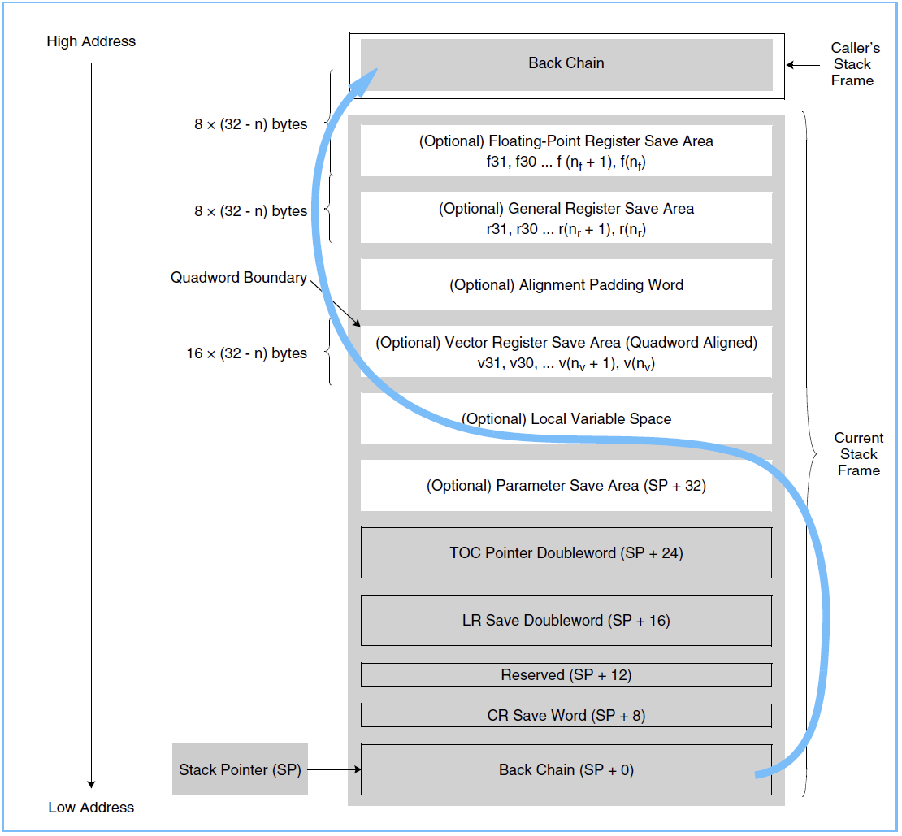
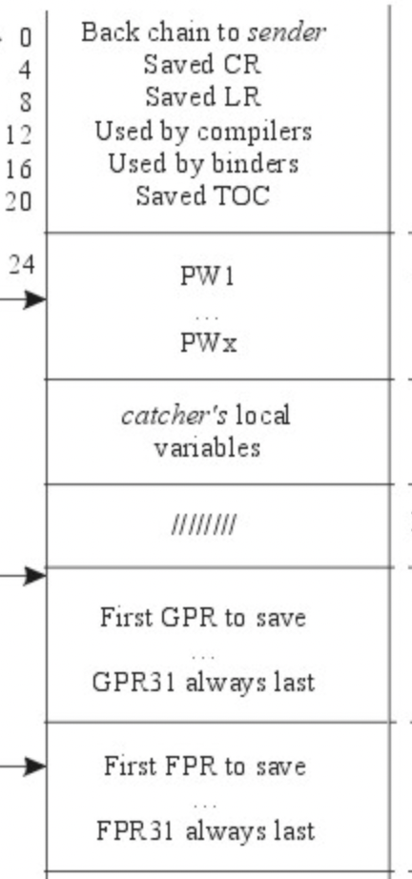
Stack frame
LE Linux
AIX
Lower address
Arguments back storage
GPR save storage
FPR save storage
Higher address

Slide 14
Argument Passing
LE Linux
AIX
Argument back storage is guaranteed
Only the first 8-slot worth are in registers
Consuming GPRs for other types of arguments
Struct/Union passed as if integer scalar(s)
Struct/Union return in hidden argument (by reference)
Argument back storage is _not_ guaranteed
Up to 21-slot worth are in registers
Consuming GPRs for other types of arguments
Homogeneous FP struct less than 8 members are treated like FP scalar(s)
Otherwise, struct is passed as if they were integer scalar(s)
Homogeneous FP struct less than 8 members are returned as if they were FP scalar(s)
Other less-than 16-byte structs are returned as if they were integer scalar(s)
Otherwise, return in hidden argument (by reference)

Slide 15
Thank you.
Resources:
AIX 7.3: https://www.ibm.com/docs/en/aix/7.3?topic=aix-assembler-language-reference
ISA and LE-Linux ABI: https://openpowerfoundation.org/specifications/

